Slide 1
Cyclistic
STUDY CASE
HOW TO ACHIEVE FAST SUCCESS OF A SHARED BIKE RENTAL BUSINESS?

Slide 2

Cyclistic
Context
Who is Cyclistic?
It is a fictional Chicago shared bike rental company.
Whats the goal?
Maximize the number of annual memberships
The Ideas
Understand differences in the use of Cyclistic bikes between casual (one trip or one day pass) cyclists and annual members

Slide 3



Cyclistic
Workflow
Steps
Prepare, organize and clean data
Analyze Data
Results
Data provided by Motivate International Inc.
Data selected from June 2022 to June 2023
Data is stored in a secure company server
Data cleaned and formats matched in R
Data analysis made in R
Calculated statistical values and resumed data
Graphs were created on R
Recommendations are presented

Slide 4
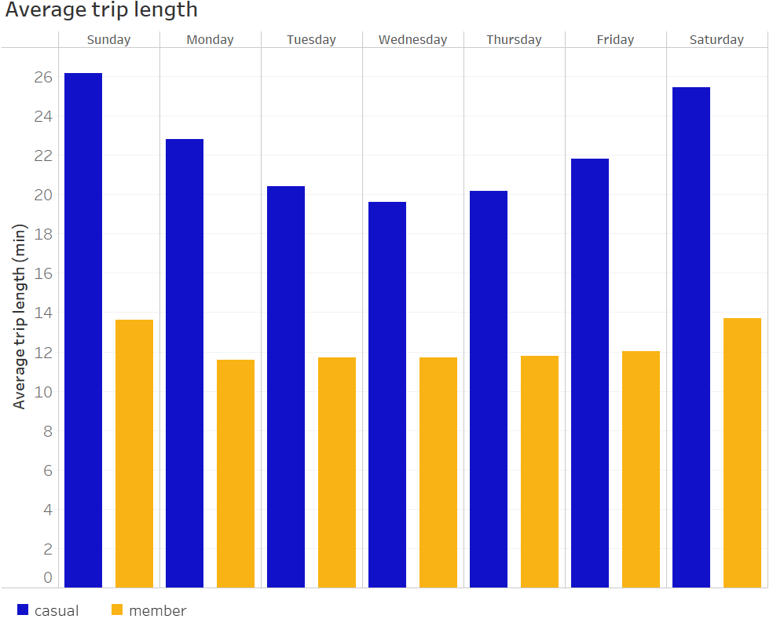
Cyclistic
Results
Average trip length per day
Casual vs Members
Data from June 2022 to June 2023 Source: summarized final data

Slide 5
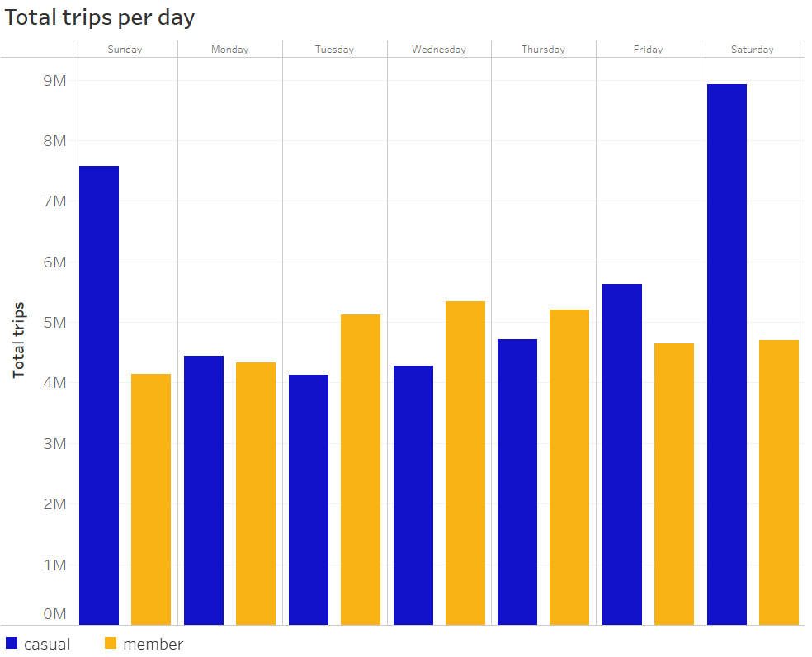
Cyclistic
Results
Total trips per day
Casual vs Members
Data from June 2022 to June 2023 Source: summarized final data

Slide 6

Cyclistic
Conclusions
There is an increment in number of trips for casual users for weekends against members
The average occasional user trip is longer than members trip
Conclusions

Slide 7

Cyclistic
Recomendations
Create a marketing campaign in the place of the docks during the weekend.
Increase the online ads during the weekend to get more casual users registered as annual members.
Get more detailed data like (user age) to create a specific marketing campaign.
Give a discount for the first year for frequent casual users
Recommendations

Slide 8
Cyclistic
THANK YOU
End Slide

Slide 9

Cyclistic
Extra
Datasets obtained from https://divvy-tripdata.s3.amazonaws.com/index.html provided by Motivate International Inc.
R Markdown Notebook available to check the cleaning and analysis process.
The summarized .csv file is attached to check the final data.
Extra

